Slide 1


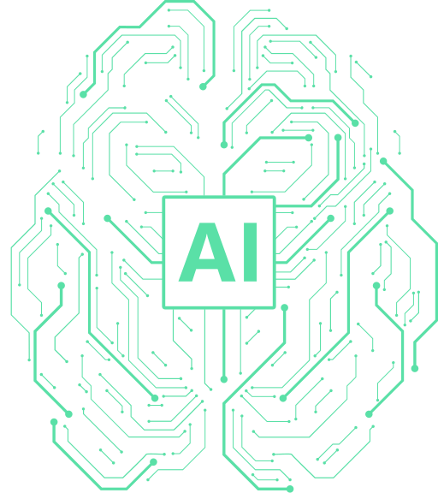

DiabetIQ
Presented to
Mr. Intisar Tahmid Naheen [ITN]
Senior Lecturer
North South University
Presented by
CSE299.17 Group 1

Slide 2


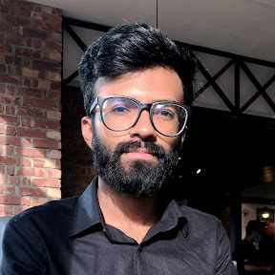
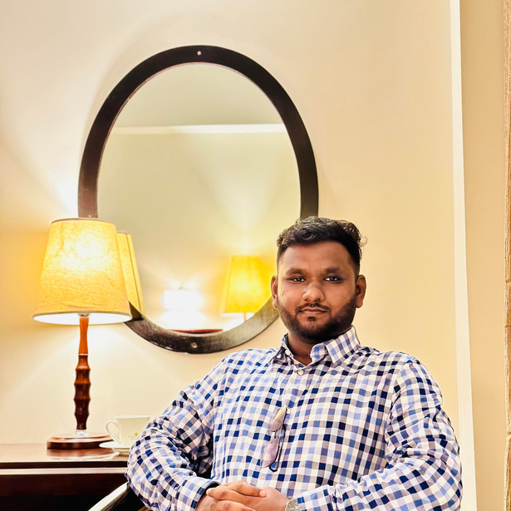
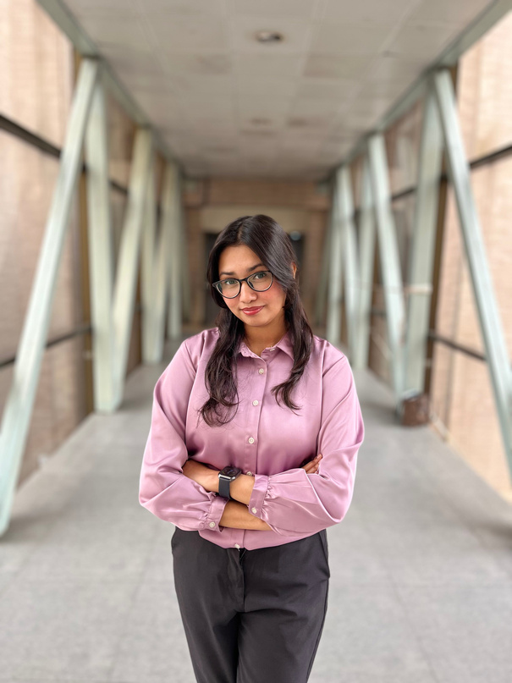
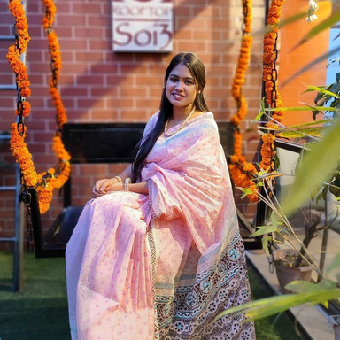
DiabetIQ
Meet the
Team
Saif Mohammed
2121913042
Nazibul Islam Nabil
2222456642
Humayra Rahman Nipa
2121128042
Umme Suraia Haque Setu
2031278642

Slide 3

DiabetIQ
Brief about the
Project
Built using Flutter for Android & iOS deployment.
Powered by Flask with MongoDB for efficient data handling.
Fine-tuned LLMs + authoritative diabetes care docs (e.g., BADAS) for accurate, contextual Q&A.
Early Type 2 diabetes risk detection from user lifestyle, symptoms and history.
Tracks medical health data of the patients and users.
Target Group: 21+ year-old male/female patients in Bangladesh diagnosed or at risk of Type-2 diabetes.
Enable early detection, enhance self-management, and reduce diabetes complications.

Slide 4
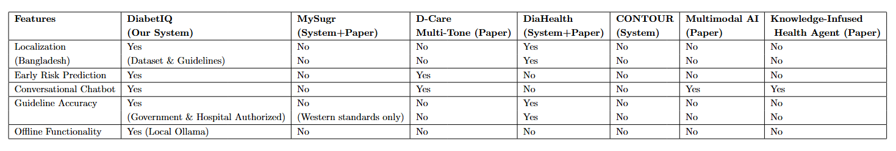
DiabetIQ
Comparison Table
System & Papers

Slide 5
DiabetIQ
Project
01
Hybrid AI Architecture (RAG + ML):
Novelties
Combines LLM-powered Q&A with ML-based predictions—proactive + reactive care in one app.
02
First Bangladesh-Focused AI Solution:
Intelligent Diabetes Management Application with an Integrated LLM-Augmented RAG Chatbot and Machine Learning-Driven Risk Prediction.
Trained on local datasets and tailored to official Bangladeshi government diabetes guidelines.
03
Smart Diabetes Care Service Model
A mobile-first service model to empower older adults of Type 2 diabetics, without requiring website access.
04
Scalable to Other Low-Resource Countries:
Architecture adaptable to similar healthcare ecosystems globally

Slide 6

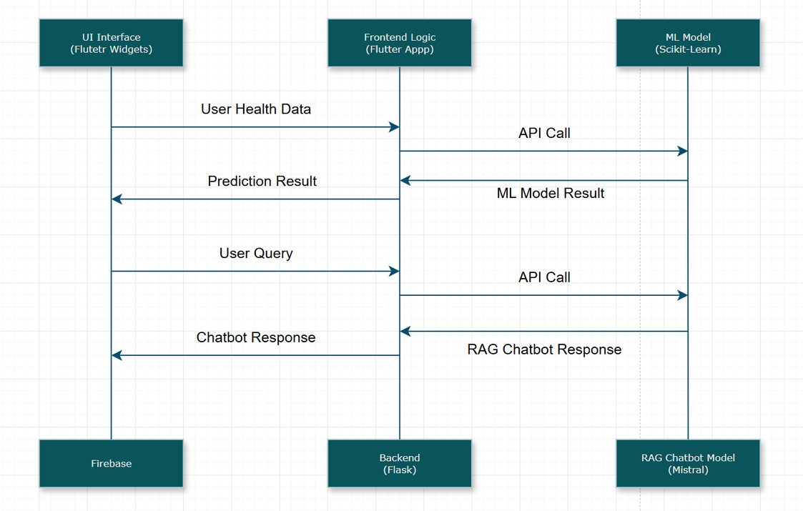
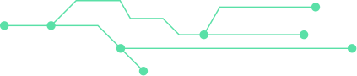
DiabetIQ
System Flowchart
Flutter App Flowchart

Slide 7
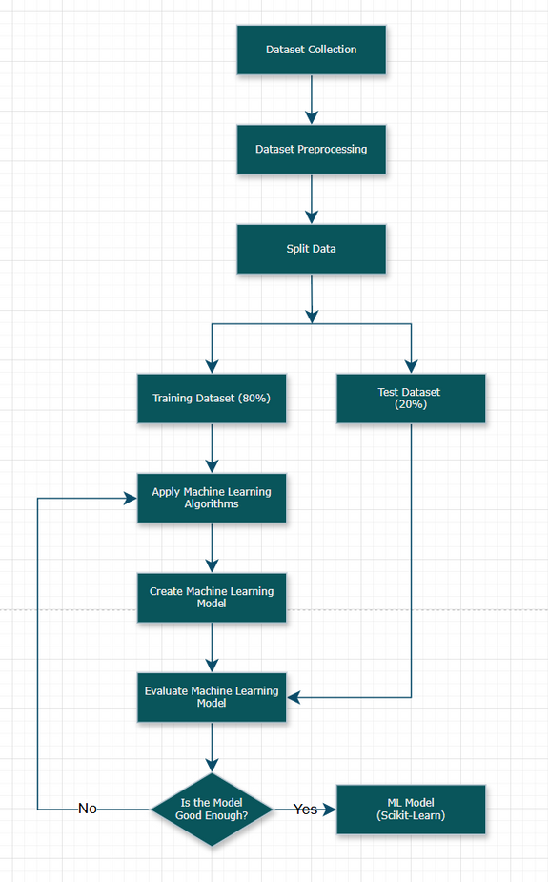
DiabetIQ
System Flowchart
ML Model

Slide 8
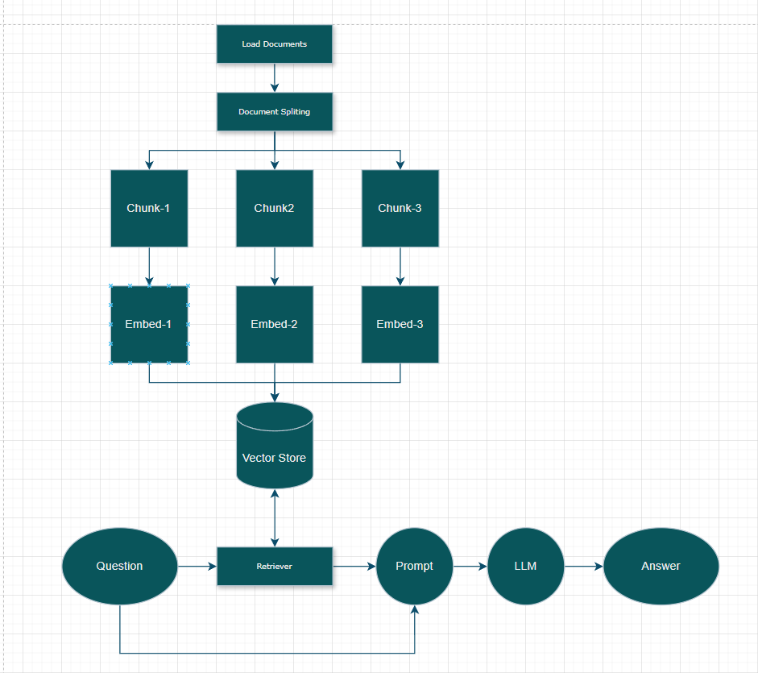
DiabetIQ
System Flowchart
Chatbot Model

Slide 9
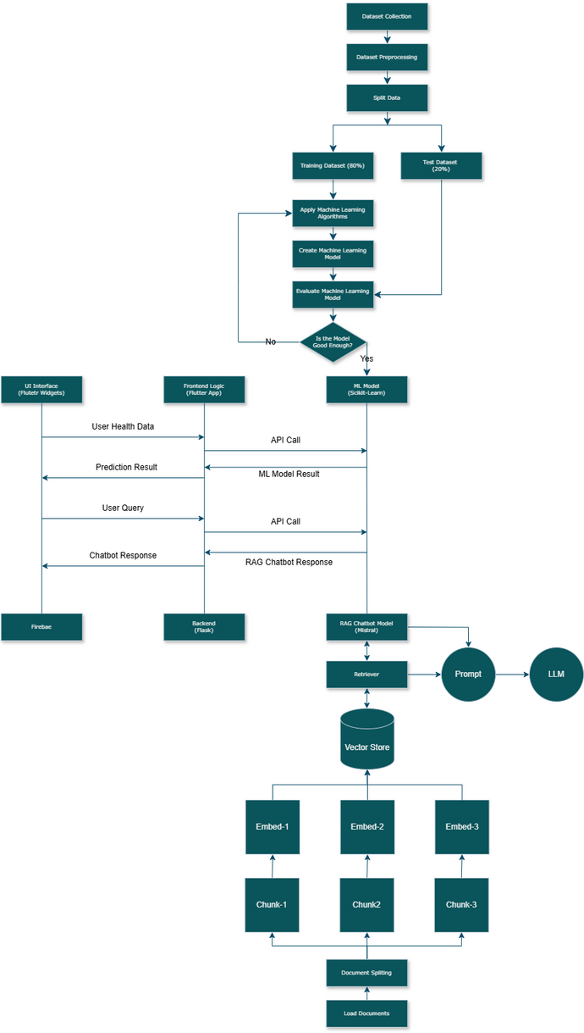
DiabetIQ
System Flowchart

Slide 10
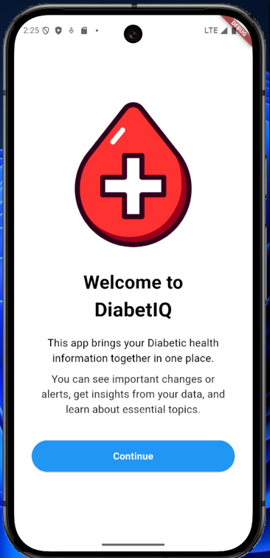
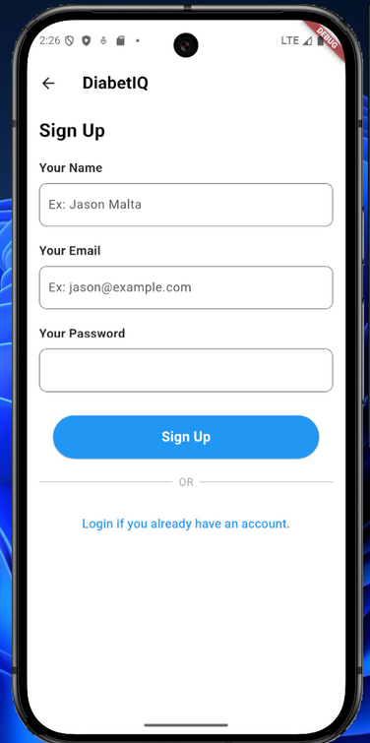
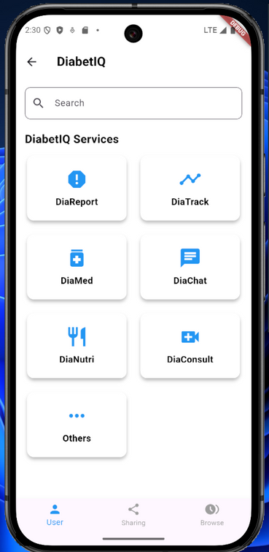
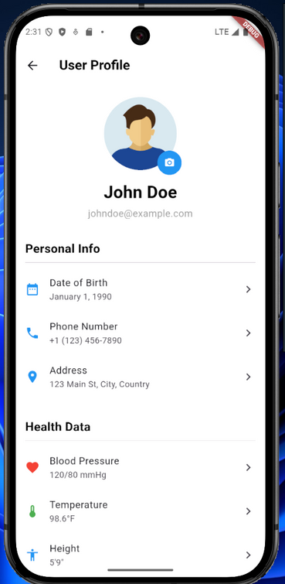
DiabetIQ
Flutter App
Demostraion

Slide 11
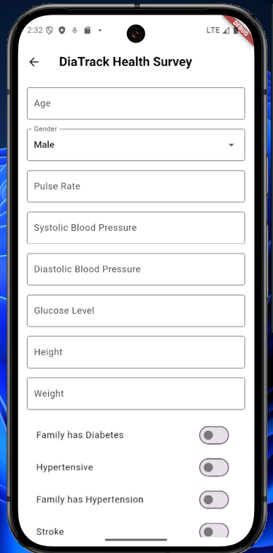
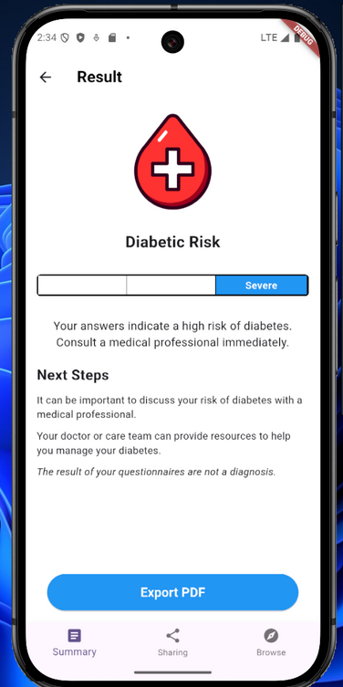
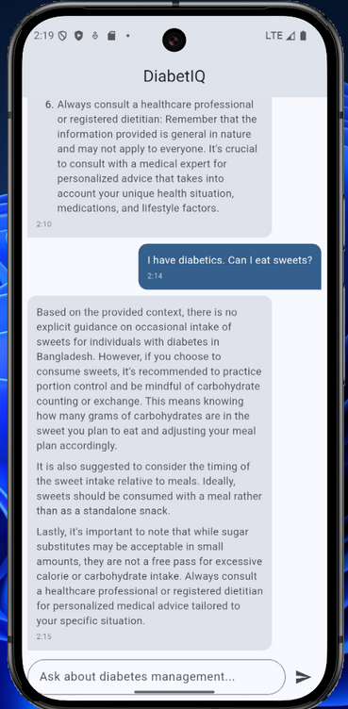
DiabetIQ
Flutter App
Demostraion

Slide 12
DiabetIQ
Individual Contribution
Saif Mohammed 2121913042
Built using Flutter for Android & iOS backend implementation.
Powered by Flask with MongoDB for efficient data handling.
LLM Prompt-engineering + authoritative diabetes care docs (e.g., BADAS) for accurate, contextual Q&A.
Evaluated RAG LLM Chatbot with different frameworks.
Early Type 2 diabetes risk detection from user lifestyle, symptoms and history.
End-to-end encryption with a privacy-first architecture.
Enable early detection, enhance self-management and reduce diabetes complications.
Studied multiple research papers.
Made final report.

Slide 13
DiabetIQ
Individual Contribution
Nazibul Islam Nabil 2222456652
Collected Diabetics Textbooks on Bangladesh scenarios.
Learned RAG Pipeline: LangChain, LangSmith
Prototyped RAG Based LLM Chatbot, Question answering.
Experimented on different LLM models, Embedding models, chunking strategies.
Performed Prompt-Tuning in RAG based LLM Q&A Chatbot.
Evaluated RAG LLM Chatbot with different frameworks.
Collected datasets to train the model.
Studied multiple research papers.
Ran the models locally.
Made presentation slides.
Modified weekly reports.

Slide 14
DiabetIQ
Individual Contribution
Humayra Rahman Nipa 2121128042
Figma design app UI implementation
FrontEnd implementation with Flutter
Set Flutter environment
Learn Dart language
Summary Documentation on Attention in Transformers: Concepts and Code in PyTorch
Watched youtube videos regarding LLM and RAG

Slide 15
DiabetIQ
Individual Contribution
Umme Suraia Haque Setu 2031278642
FrontEnd implementation with Flutter
Set Flutter environment
Learn Dart language
Summary Documentation on Attention in Transformers
Watched youtube videos regarding LLM and RAG

Slide 16
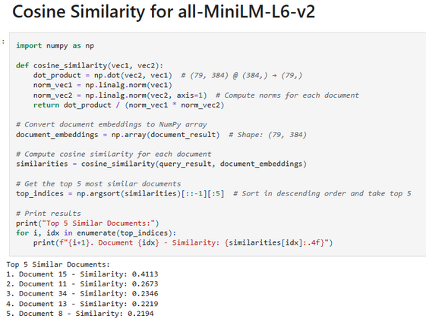
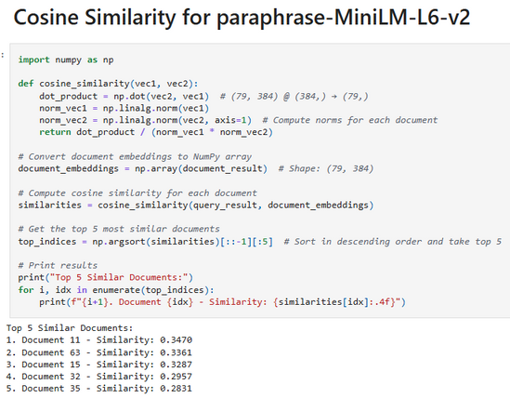
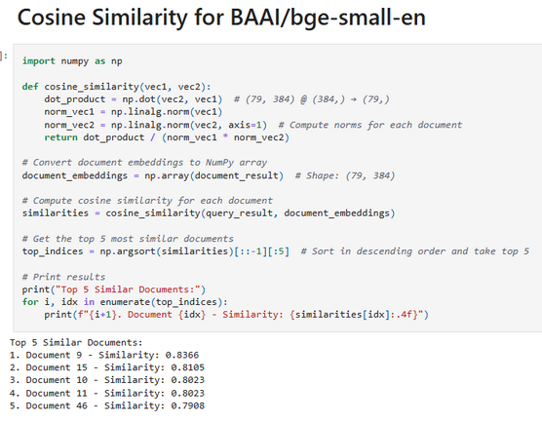
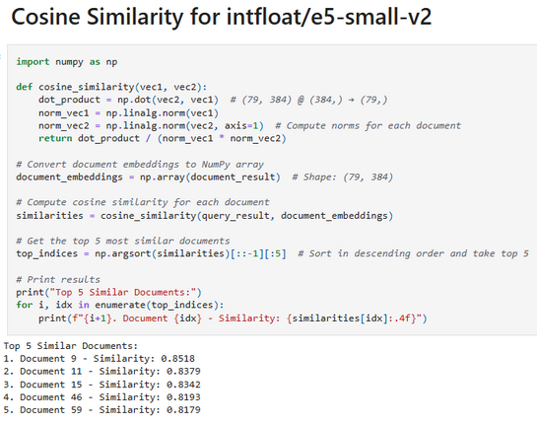
DiabetIQ
Result & Comparison
Embedding Models
all-MiniLM-L6-v2
paraphrase-MiniLM-L6-v2
BAAI/bge-small-en
infloat/e5-small-v2

Slide 17
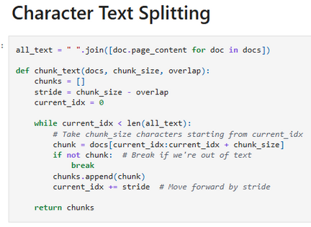
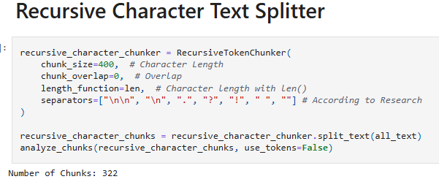
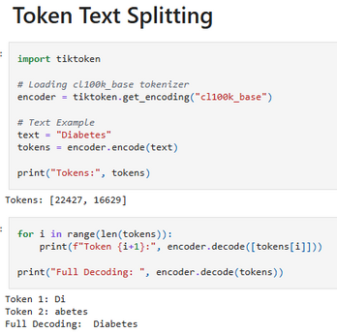
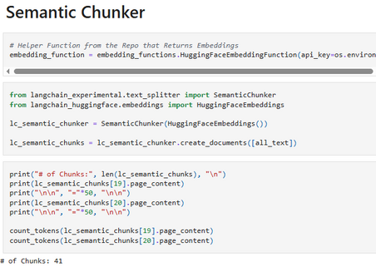
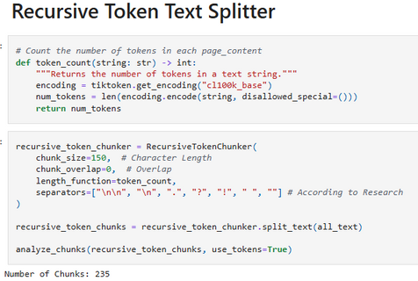
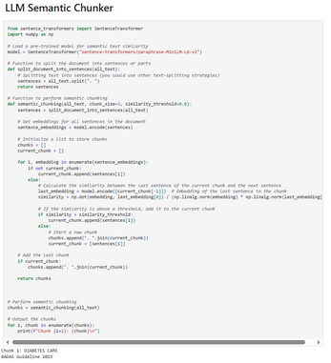
DiabetIQ
Result & Comparison
Chuncking Strategies
Character Text Splitting
Recursive Character Text Splitter
Token Text Splitting
Semantic Chunker
Recursive Token Text Splitter
LLM Semantic Chunker

Slide 18
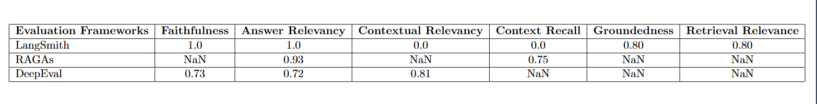
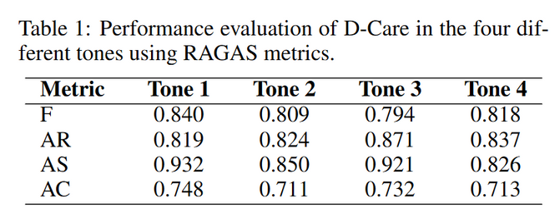
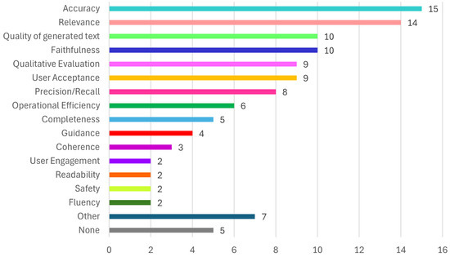
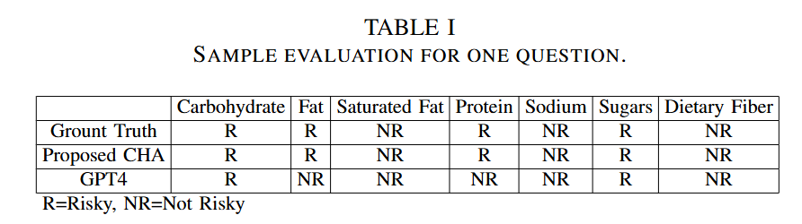
DiabetIQ
Result & Comparison
Chatbot Evaluation
DiabetIQ Chatbot Model
Existing Models (Papers)

Slide 19
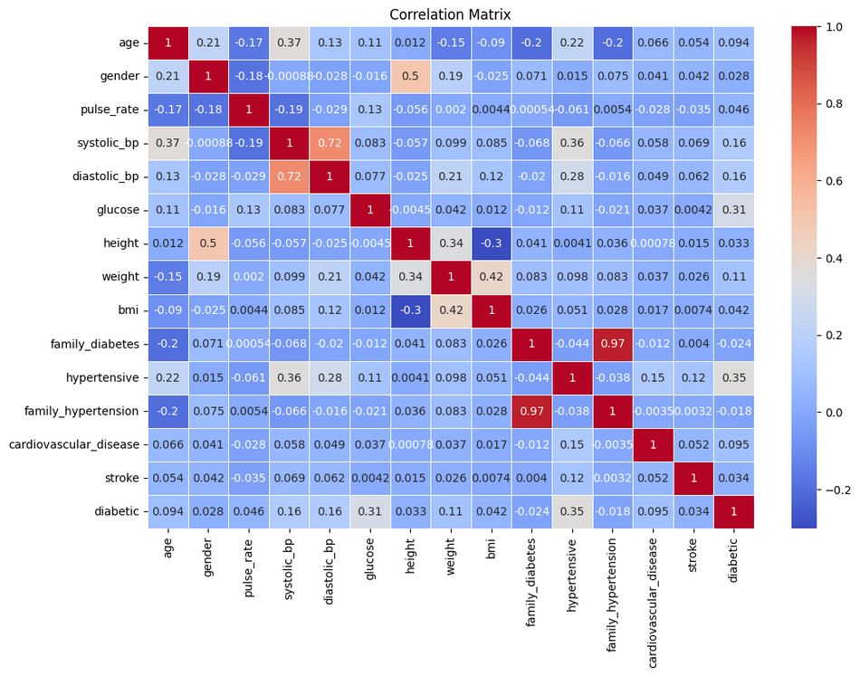
DiabetIQ
Result & Comparison
Correlation Matrix

Slide 20
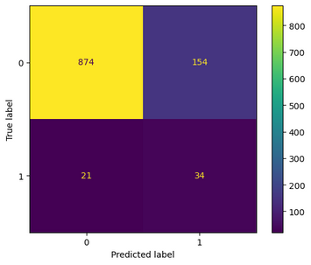
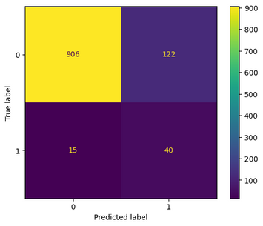
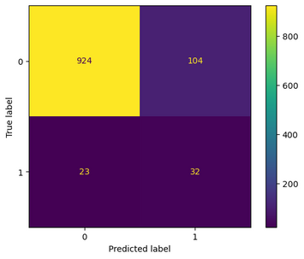
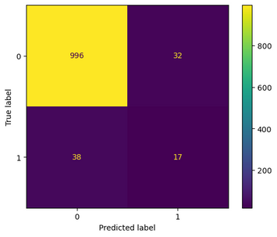
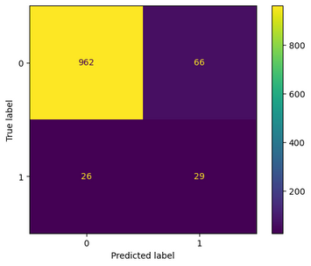



DiabetIQ
Result & Comparison
Confusion Matrix
KNN
Logistic Regression
AdaBoost
XGBoost
Gradient Boosting Classifier
SVM
Random Forest
Decision Tree

Slide 21
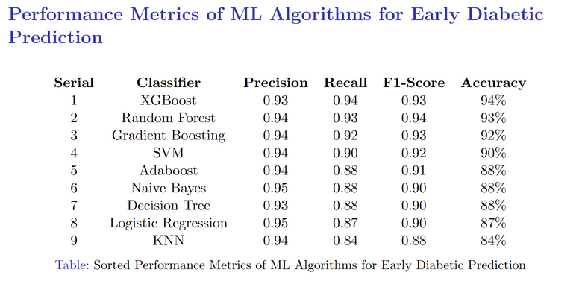
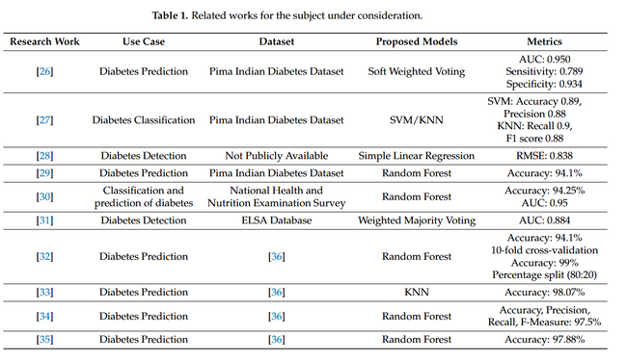
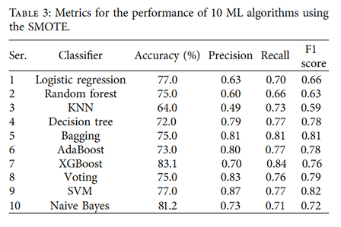
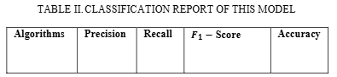
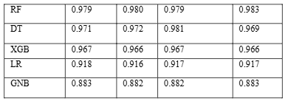
DiabetIQ
Result & Comparison
ML Algorithms
DiabetIQ ML Model
Existing Models (Papers)

Slide 22
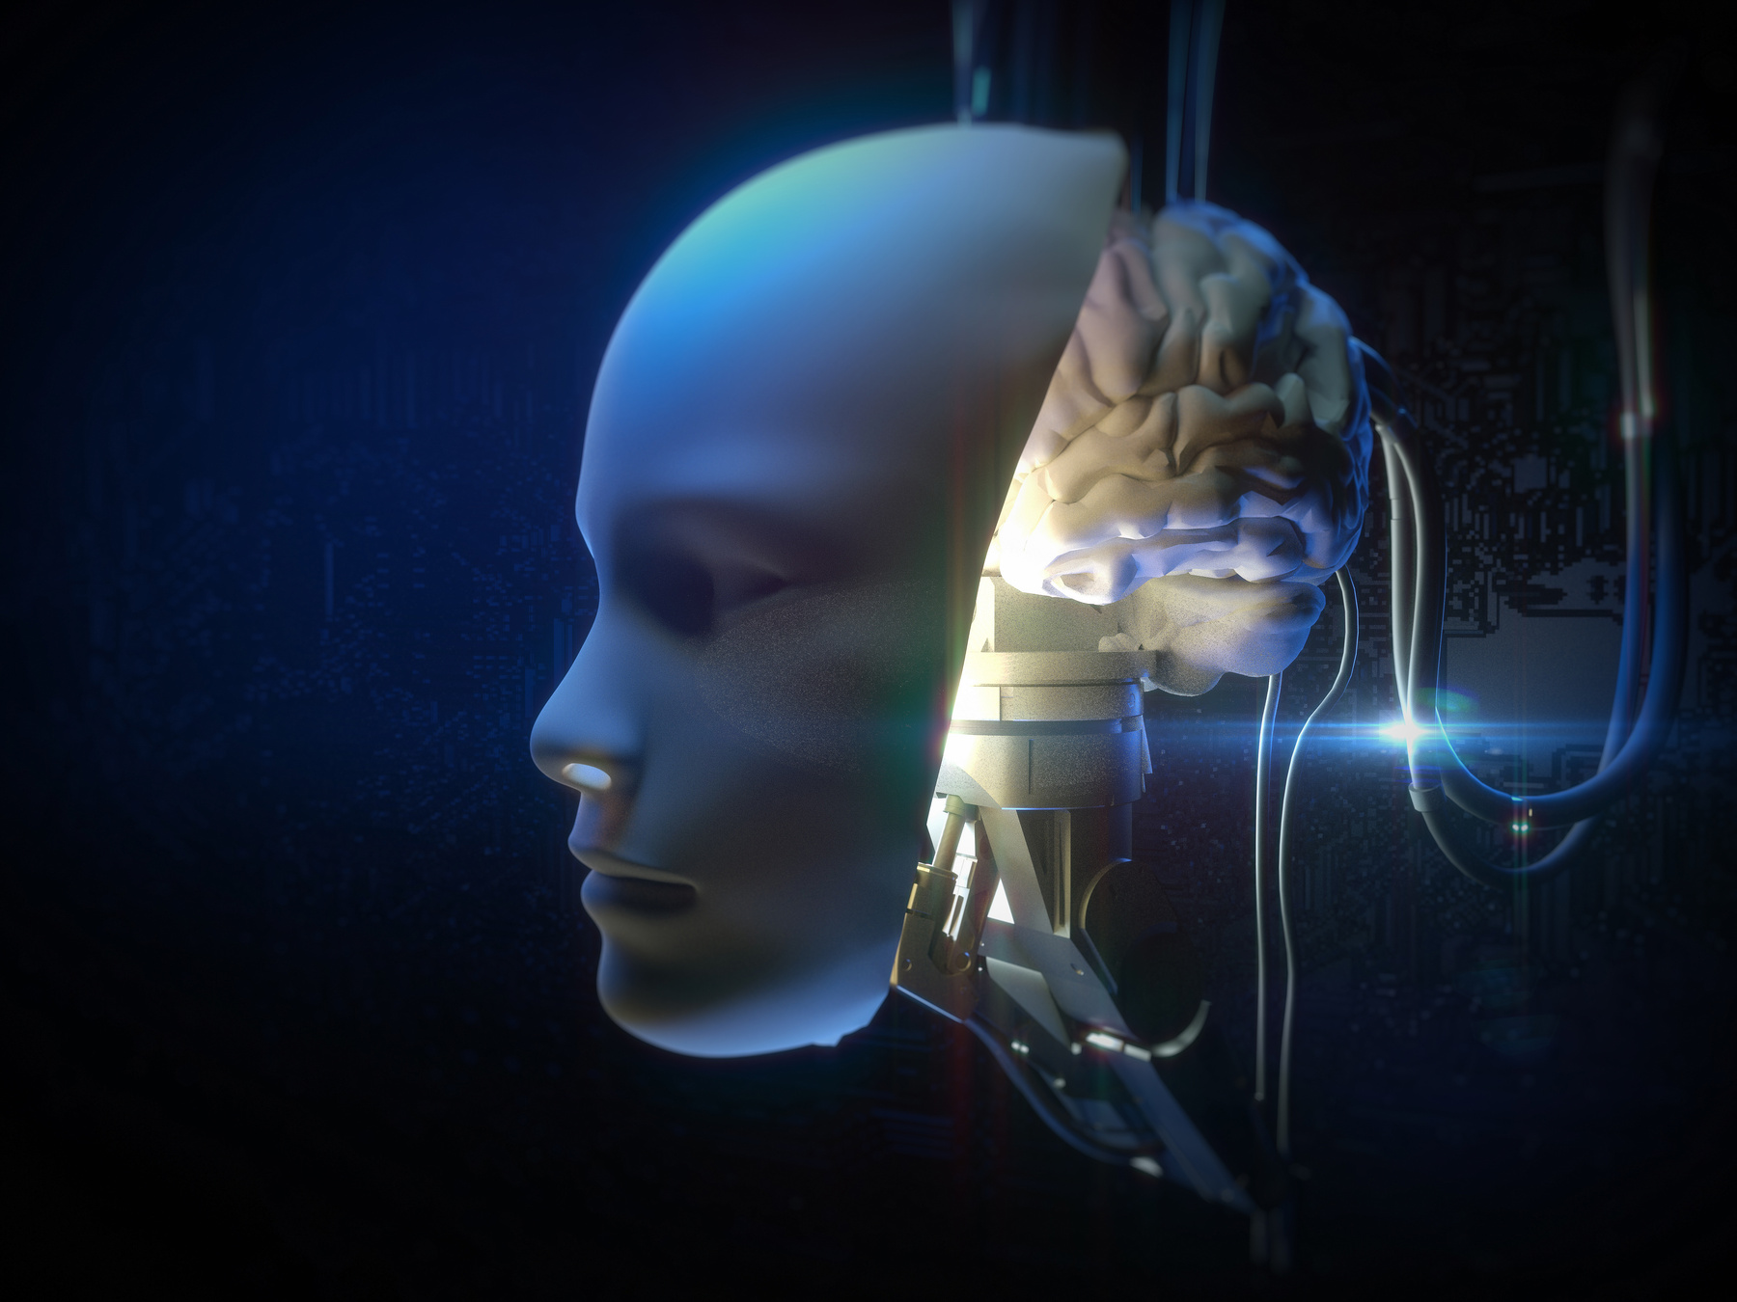
DiabetIQ
Proposed
Future Works
Personalized Health Optimization Using Encrypted Data.
Agent-based Appointment Feature.
Multilingual and Voice-Enabled Interaction.
Modular Healthcare Service Integration.
Automated Medical Report Scanner.
Live Telemedicine and Specialist Consultation.
Diabetes Medication Support System.
Research Paper Publication Scope.

Slide 23
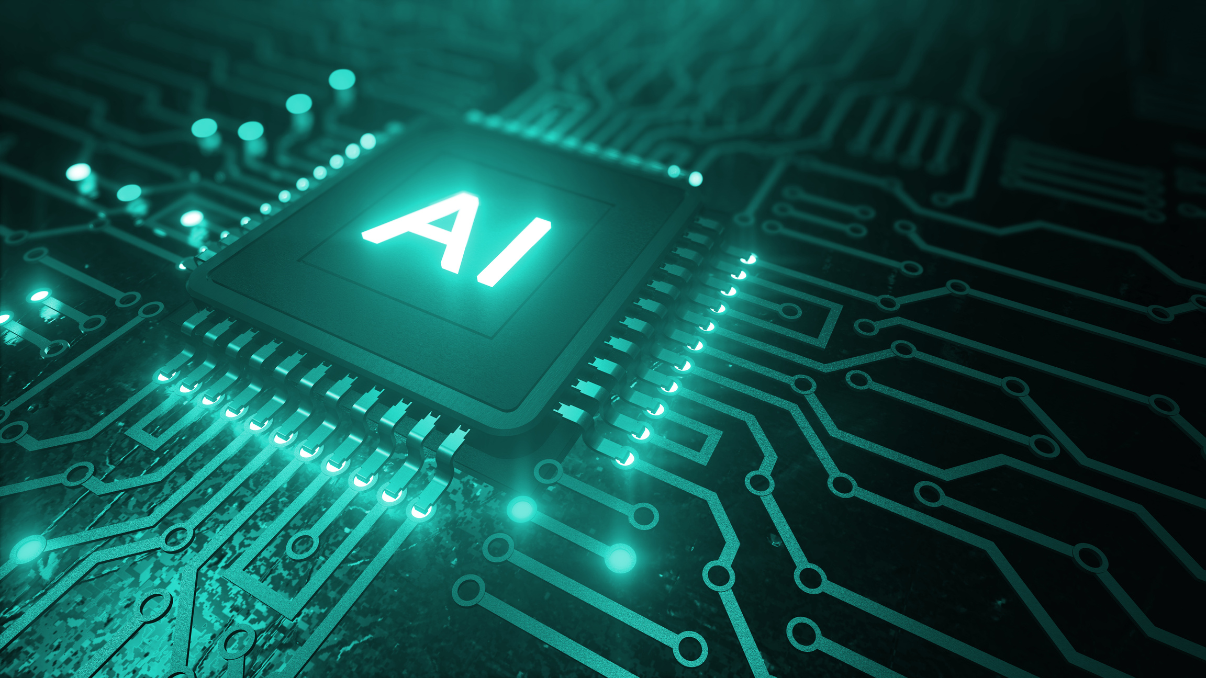
DiabetIQ
Conclusion
DiabetIQ is a pioneering AI-powered mobile solution designed specifically for the Bangladeshi population facing the growing diabetes crisis.
Combines LLM-based guidance, ML-driven prediction, and localized healthcare data for proactive, and accessible diabetes care.
Bridges the AI-healthcare gap in low-resource settings through innovative hybrid architecture and cultural relevance.
Aims to empower patients, support early detection and reduce long-term complications.
Lays the groundwork for scalable, research-driven solutions adaptable to other developing nations.

Slide 24


DiabetIQ
Thank
You

